Slide 1
MTN-023/IPM 030 Common QCs
30 April 2015
Updated 29 December 2015

Slide 2
What are the most common QCs and data queries for MTN-023/IPM 030 so far?

Slide 3
QC Statistics
Missing QCs | Illegible QCs | Inconsistent QCs | Illegal QCs | Other
230 | 29 | 243 | 39 | 183

Slide 4
Common QC Trends
Skip patterns not followed (inconsistent data)
Recording data incorrectly, specifically numbers
Illegible handwriting
Incomplete form completion (missing data)
Missing initials/date for corrections

Slide 5
Skip Patterns
Pay attention to skip patterns for proper form completion and completeness.
Inconsistent responses. Items 6a and items 2 should not have a response.
Notes:
Item 6 from Vaginal Practices – here, since ‘yes’ is marked, this should be the end of the form and no additional responses should be marked but item 6a is marked.
Item 1 and 2 from Ring Adherence – here item 1 is marked no and this should be the end of the form, yet there is a response for item 2.

Slide 6
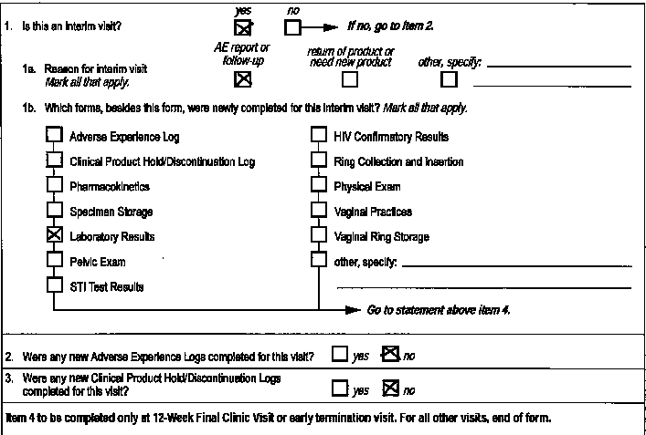
Skip Patterns Continued
Items 2 and 3 should not have a response since this is an interim visit per the skip pattern.
Notes:
If interim visit, should not have responses to items 2 and 3 per the skip pattern. If interim visit, 1b should indicate which forms to expect and prompt after says to go to statement above item 4.

Slide 7
Pay attention to the prompts!
Notes:
This has been another common QC. Per the form instructions, this should only be filled out at Visit 11.0 (24-week final clinic visit) or early termination visit. This has often been filled out for visits other than Visit 11 or early term visit.
If it is 24 week visit or early termination visit, Yes or no response should be marked for those who were randomized to complete IDI. Not required should be marked for those who were not randomized.

Slide 8
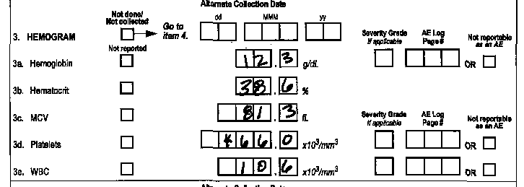
Recording Numbers
Remember to right justify all numbers and fill in any blank leading boxes with zeroes.
These responses resulted in QCs because not all boxes were complete.
Notes:
Just a reminder that how to fill out numbers is in the SSP Section 11.2.3.

Slide 9
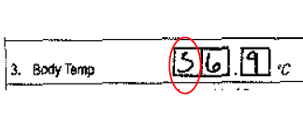
Recording Numbers
Remember to make all responses legible.
Below are a couple of examples that resulted in QCs because the responses were illegible in iDataFax.
Notes:
Write the number(s) as large as possible while staying within the boundaries of the
box; try not to stray outside the boundaries of the box.
The simpler, the better – no loops

Slide 10
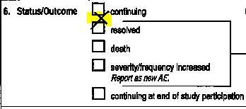
Illegible handwriting
Not just numbers – some QCs were placed due to illegible handwritten responses or which checkbox was supposed to be marked was not clear.
Notes:
Most QCs due to illegibility are due to numbers not being clear, but there have been a few QCs where the handwritten responses or which box was checked was not clear and resulted in QCs. Here are some examples.
(Increase
Continuing or resolved?
shipping

Slide 11
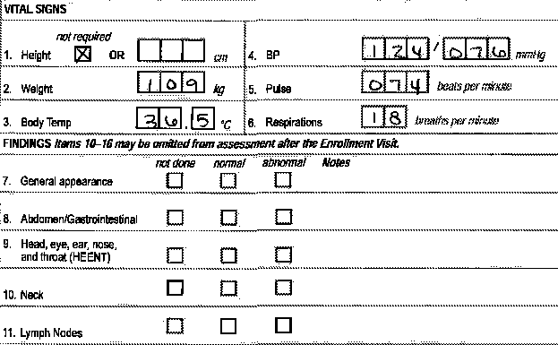
Form Completion
Be sure to answer all required questions/items for any given CRF before faxing in forms.
During QC review, make sure all items have a response or are marked “not (done/reported/collected)”. Items can only be left blank if explicitly stated in skip pattern.
Notes:
Physical Exam CRF.
In this case, some items may have been omitted when doing the actual targeted physical exam per protocol, but this still needs to be documented as not done.

Slide 12
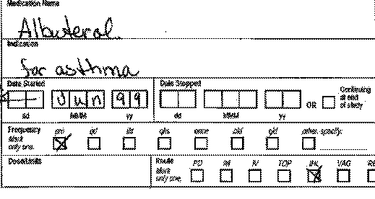
A few more examples of incomplete form completion…
Missing responses for items.
Complete all fields for each medication recorded.
Notes:
first image is from the STI Test results CRF. Here test type is marked but a result is not marked. Just a reminder, for lab CRFs, wait until all results are received and transcribed onto CRF before faxing CRF to SCHARP.
The bottom images are from the Con Meds CRF

Slide 13
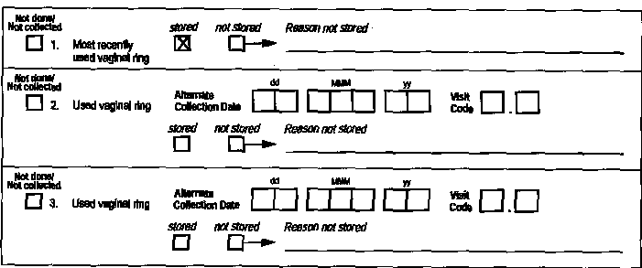
Form Completion Continued
Don’t forget items 2 and 3!
Notes:
Another example from the Physical Exam CRF - Here we expect a response in the Notes column since abnormal was marked as indicated on the back of the form instructions.
Bottom example is from Vaginal Ring Storage CRF – even if only 1 ring was stored, still need responses for item’s 2 and 3.

Slide 14
Form Completion Continued
For CRFs that serve as source documentation, it is important to review the completed form at the end of the participant interview to make sure all required items have a response.
Accidentally skipped items will need to be lined through, written as “missing”, and initialed/dated.
Notes:
This example is from the Vaginal Practices CRF.

Slide 15
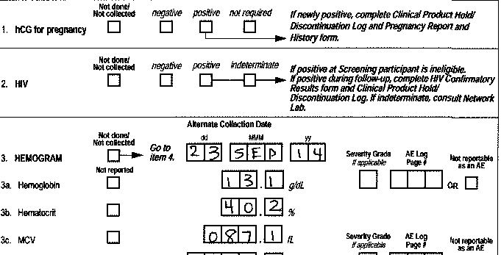
Remember to Initial/Date ANY changes
Remember to initial and date ALL changes/ updated responses before re-faxing in any forms.
Includes corrections and additions to data
Notes:
A very common QC I have seen is now that corrections/updates have been made to the CRFs after they have been refaxed, often the initials and date are missing.
Originally this form was faxed in with no responses on items 1 and 2.

Slide 16
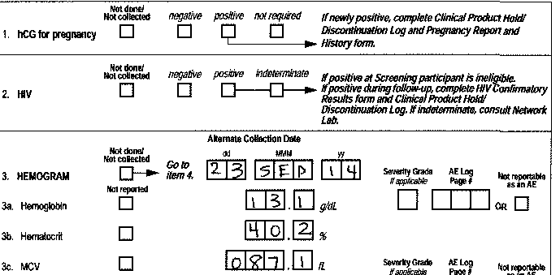
MP 02/Oct/14
MP 02/Oct/14
Notes:
Remember to initial and date the additions of item 1 and 2 as seen in this slide.

Slide 17
Remember to update AE and CM at Termination
AE Outcome Status: Enter “Status/Outcome Date” OR mark “Continuing at end of study participation” box
Con Meds Log: Enter “Date Stopped” or mark “Continuing at end of study” box
Notes:
What is your site’s process for updating forms once a ppt has terminated from the study?

Slide 18
Common QCs on CRFs
STI Test Results
Ring Collection and Insertion
Specimen Storage
Adverse Experience Log

Slide 19
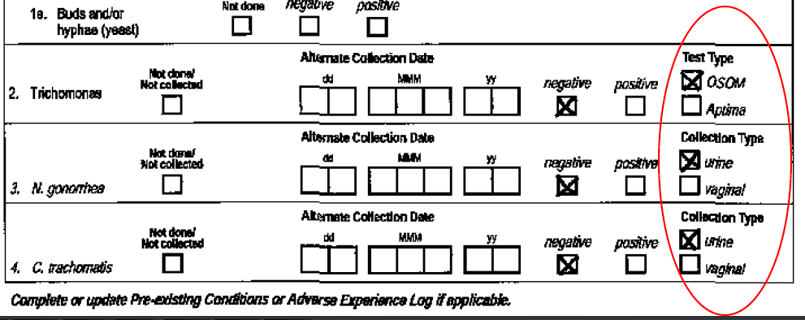
STI Test Results (STI-1) CRF – Items 2, 3, and 4
Items 2, 3, and 4
If Items 2, 3, and 4 are completed, ensure that there is a response for “Test Type”
Notes:
Often test type has been missing a response.

Slide 20
Ring Collection and Insertion (RCI-1) CRF – Item 1a
If item 1 is marked no, please ensure there is a response for item 1a.
This is incorrect and resulted in a QC:
This is correct since there is a response for item 1a:

Slide 21
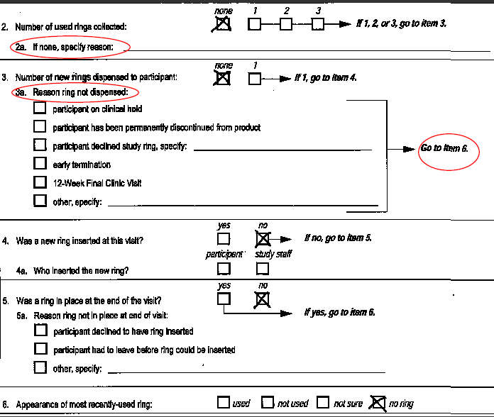
Ring Collection and Insertion (RCI-1) CRF
Pay particular attention to the skip patterns on this form!
Ex: If Item 2 ‘number of used rings collected’ is ‘none’, a reason is required in Item 2a. If ‘1’, ‘2’, or ‘3’, go to Item 3.
Ex. If item 3 ‘number of new rings dispensed to ppt’ is ‘none’, item 3a should be completed, skip items 4 and 5, and complete Item 6, ‘Appearance of most recently used-ring’.
Notes:
This form has been a common form to have QCs.

Slide 22
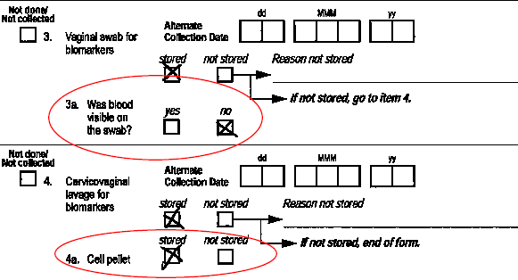
Specimen Storage (SS-1) CRF
Item 3a and 4a
If Item 3 (Vaginal swab for biomarkers) is marked as ‘stored’, item 3a, “Was blood visible on the swab?” must be completed.
If Item 4 (Cervicovaginal lavage for biomarkers) is marked as ‘stored’, item 4a (Cell pellet) must be completed.

Slide 23
Adverse Experience Log (AE-1) CRF
Common QC: Missing rationale or alternative etiology
If Item 4 is marked ‘not related’, please ensure a rationale is recorded in the Comments section.

Slide 24
Helpful tips to prevent QCs
Look for common QC errors when doing internal QC review. Prioritize review and faxing of AE Log and PH Log (for safety monitoring)
Verify PTID and visit code
Keep a separate tab for log CRFs (Con Meds, AE Log, PH Log) in each participant binder
Helps ensure correct page numbering and that completed pages are faxed.
Notes:
Tips to use in general, and when doing internal QC review prior to faxing CRFs to SCHARP for first time.

Slide 25
Helpful tips to prevent QCs continued
Keep Data Collection SSP section, Data Communiqués, and severity grade range “cheat sheet” handy
Limit during-visit QC review (before participant leaves clinic) to source documents only
Reduces review time and ensures a more thorough review of source documents to prevent missing data
Have regularly scheduled meetings with site QC staff to discuss trends and provide additional training as needed

Slide 26
Helpful tips when resolving QCs
Resolve all QCs for one PTID before moving on to the next participant’s records.
Fax all updated CRFs for a given PTID together, to avoid inconsistent QCs.
When correcting one form, remember to update other forms for consistency as needed.
Always initial/date each form change.

Slide 27
Helpful tips when resolving QCs continued
CRF changes do NOT need to be made by the person who completed the form/made the error.
By referring to available source docs:
Clinical staff can resolve queries on clinical forms
Data staff can resolve non-clinical QCs
Helpful to bring error to attention of person who made it, but don’t need to wait for him/her to resolve QC

Slide 28
Documentation of Missed and Interim Visits
If a visit is missed, make sure to fill out a Missed Visit CRF!
Make sure to fill out a FVS CRF for all visits, including interim visits that result in additional CRF documentation

Slide 29
When in doubt…
Refer to form instructions on back of CRF
Refer to SSP Section 11 (Data Collection) and Data Communiqués
Ask site colleagues
Ask SCHARP (Email Melissa and Jenn: mapeda@scharp.org and jens@scharp.org)

Slide 30
iDataFax View only Access
iDataFax view access allows your site to view the faxed CRF images and data
View QCs, clinical queries, identify missing CRF pages or study visits at any time
Confirm queries are resolved after paper CRF refax
Notes:
Is your site using this?

Slide 31
Questions
Please contact Melissa Peda with any questions you have about this slide set, QCs, or general data management issues.
Email: mapeda@scharp.org
Phone: 206-667-7672

